Slide 1




Slide 2
CHAPTER 3
FUNCTIONS, METHODS & OBJECTS

Slide 3
WHAT IS A FUNCTION?

Slide 4
Functions let you group a series of statements together to perform a specific task.

Slide 5
Functions are reusable and save you from writing out the same code over and over.

Slide 6
DECLARING A FUNCTION

Slide 7
function

Slide 8
function sayHello()

Slide 9
function sayHello() { document.write(‘Hello’);
}

Slide 10
function sayHello() { document.write(‘Hello’);
}
KEYWORD

Slide 11
function sayHello() { document.write(‘Hello’);
}
FUNCTION NAME

Slide 12
function sayHello() { document.write(‘Hello’);
}
CODE BLOCK (IN CURLY BRACES)

Slide 13
CALLING A FUNCTION

Slide 14
sayHello();

Slide 15
sayHello();
FUNCTION NAME

Slide 16
DECLARING A FUNCTION THAT NEEDS INFORMATION

Slide 17
function

Slide 18
function getArea()

Slide 19
function getArea(width, height)

Slide 20
function getArea(width, height) { return width * height;
}

Slide 21
function getArea(width, height) { return width * height;
}
PARAMETER
PARAMETER

Slide 22
function getArea(width, height) { return width * height;
}
THE PARAMETERS ARE USED LIKE VARIABLES WITHIN THE FUNCTION

Slide 23
CALLING A FUNCTION THAT NEEDS INFORMATION

Slide 24
getArea(3, 5);

Slide 25
getArea(3, 5);
ARGUMENTS

Slide 26
OBJECTS

Slide 27
Objects group together variables and functions to create a model.

Slide 28
In an object, variables and functions take on new names. They become properties and methods.

Slide 29
Each property or method consists of a name (also known as a key) and its corresponding value.

Slide 30
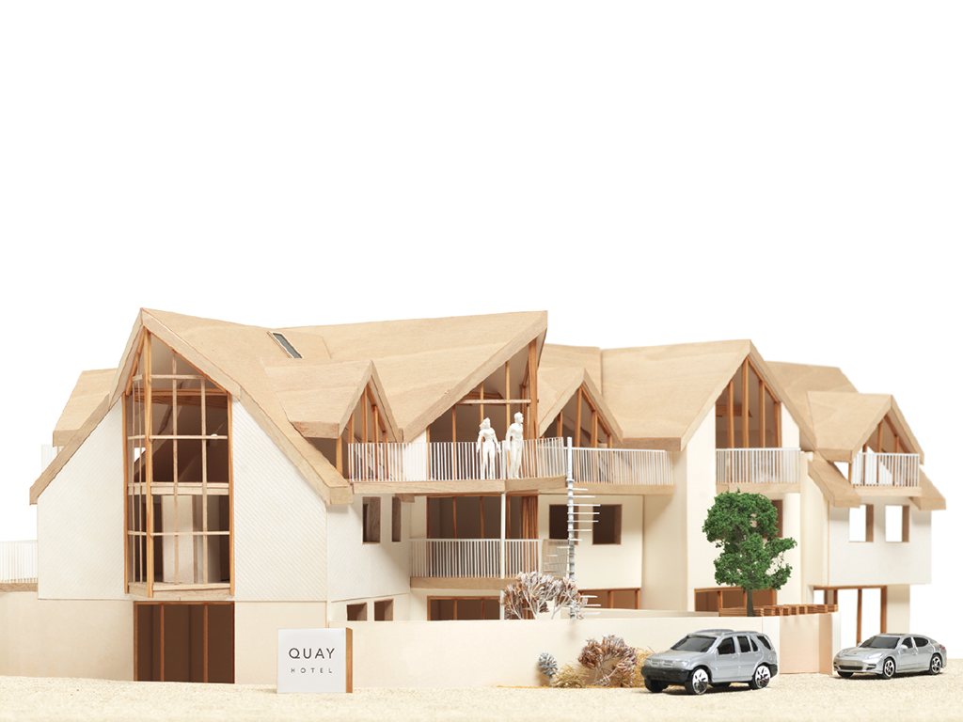
var hotel = {
name: ‘Quay’,
rooms: 40,
booked: 25,
gym: true,
roomTypes: [‘twin’, ‘double’, ‘suite’],
checkAvailability: function() {
return this.rooms - this.booked;
}
};

Slide 31
var hotel = {
name: ‘Quay’,
rooms: 40,
booked: 25,
gym: true,
roomTypes: [‘twin’, ‘double’, ‘suite’],
checkAvailability: function() {
return this.rooms - this.booked;
}
};

Slide 32
NAMES (KEYS)
var hotel = {
name: ‘Quay’,
rooms: 40,
booked: 25,
gym: true,
roomTypes: [‘twin’, ‘double’, ‘suite’],
checkAvailability: function() {
return this.rooms - this.booked;
}
};

Slide 33
VALUES
var hotel = {
name: ‘Quay’,
rooms: 40,
booked: 25,
gym: true,
roomTypes: [‘twin’, ‘double’, ‘suite’],
checkAvailability: function() {
return this.rooms - this.booked;
}
};

Slide 34
PROPERTIES
var hotel = {
name: ‘Quay’,
rooms: 40,
booked: 25,
gym: true,
roomTypes: [‘twin’, ‘double’, ‘suite’],
checkAvailability: function() {
return this.rooms - this.booked;
}
};

Slide 35
METHOD
var hotel = {
name: ‘Quay’,
rooms: 40,
booked: 25,
gym: true,
roomTypes: [‘twin’, ‘double’, ‘suite’],
checkAvailability: function() {
return this.rooms - this.booked;
}
};

Slide 36
ACCESSING OBJECTS

Slide 37
var hotelName = hotel.name;

Slide 38
var hotelName = hotel.name;
OBJECT

Slide 39
var hotelName = hotel.name;
PROPERTY

Slide 40
var hotelName = hotel[‘name’];

Slide 41
var hotelName = hotel[‘name’];
OBJECT

Slide 42
var hotelName = hotel[‘name’];
PROPERTY

Slide 43
UPDATING OBJECTS

Slide 44
hotel.name = ‘Park’;

Slide 45
hotel.name = ‘Park’;
OBJECT

Slide 46
hotel.name = ‘Park’;
PROPERTY

Slide 47
hotel.name = ‘Park’;
NEW VALUE

Slide 48
hotel[‘name’] = ‘Park’;

Slide 49
hotel[‘name’] = ‘Park’;
OBJECT

Slide 50
hotel[‘name’] = ‘Park’;
PROPERTY

Slide 51
hotel[‘name’] = ‘Park’;
NEW VALUE

Slide 52
BUILT-IN OBJECTS

Slide 53
1

Slide 54
1
Browser Object Model
THE WEB BROWSER

Slide 55
BROWSER OBJECT MODEL
PROPERTIES INCLUDE: window.innerHeight window.innerWidth window.screenX window.screenY
METHODS INCLUDE: window.print()

Slide 56
2
1
Browser Object Model
THE WEB BROWSER

Slide 57
2
1
Browser Object Model
THE WEB BROWSER
Document Object Model
THE PAGE LOADED IN THE WEB BROWSER (OR TAB)

Slide 58
DOCUMENT OBJECT MODEL
PROPERTIES INCLUDE: document.title document.lastModified
METHODS INCLUDE: document.write() document.getElementById()

Slide 59
3
1
2
Browser Object Model
THE WEB BROWSER
Document Object Model
THE PAGE LOADED IN THE WEB BROWSER (OR TAB)

Slide 60
1
2
3
Browser Object Model
THE WEB BROWSER
Document Object Model
THE PAGE LOADED IN THE WEB BROWSER (OR TAB)
Global JavaScript Objects
GENERAL PURPOSE OBJECTS JAVASCRIPT NEEDS TO WORK

Slide 61
GLOBAL JAVASCRIPT OBJECTS
PROPERTIES INCLUDE: saying.length
METHODS INCLUDE: saying.toUpperCase() saying.toLowerCase() saying.charAt(3)

Slide 62


